Slide 1


Cloud Security: Protecting Your Digital Assets in the Cloud
20127318 – Phan Trí Tài

Slide 2
CONTENTS
01
Introduction to Cloud
06
Cloud Security Standards
02
Cloud Security Challenges
07
PROJECTS
03
Cloud Security Techniques
04
Cloud Security Architectures
05
5 Key Components of Cloud Security Architecture

Slide 3
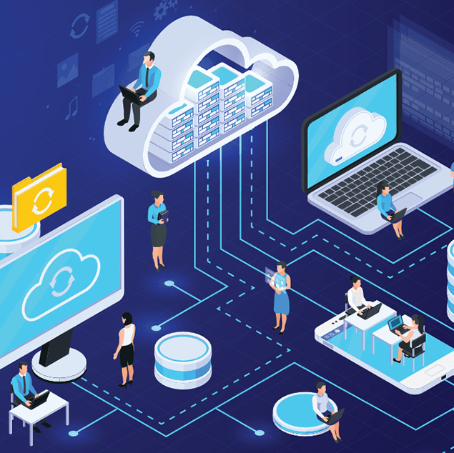
Introduction to Cloud
Cloud computing is a computing model that uses computer technology and develops based on the Internet.
Cost-effective
Scalable
Enhances flexibility.

Slide 4

Cloud Security Challenges
Securing third-party software and insecure APIs.
Lack of visibility.
Lack of cloud security professionals.
Cloud data governance.
Shadow IT.
Managing a rapidly evolving attack surface.
Multi-cloud security.

Slide 5
Cloud Security Challenges
Securing third-party software and insecure APIs
Lack of cloud security professionals
Lack of visibility
Cloud data governance
Difficulty in managing and responding promptly to threats arises when there is a lack of comprehensive visibility into the infrastructure and data
Ensuring the security of third-party software and APIs is crucial to prevent the exploitation of security vulnerabilities
Effective data governance is essential to avoid security risks, compliance issues, and other concerns during the migration of data to the cloud
The scarcity of skilled personnel for cloud security poses challenges in effectively safeguarding cloud environments

Slide 6
Cloud Security Challenges
Managing a rapidly evolving attack surface
Shadow IT
Multi-cloud security
The use of unauthorized resources creates security holes due to a lack of control and visibility over unapproved applications, services, or devices
Coordinating security measures and ensuring consistent protection across diverse cloud platforms become challenging in a multi-cloud strategy
Adapting security measures to address new threats and vulnerabilities introduced by emerging technologies is necessary as the attack surface expands

Slide 7
Multi-Factor Authentication (MFA)
Cloud Security Techniques
Encryption
Firewalls and Network Security
….

Slide 8
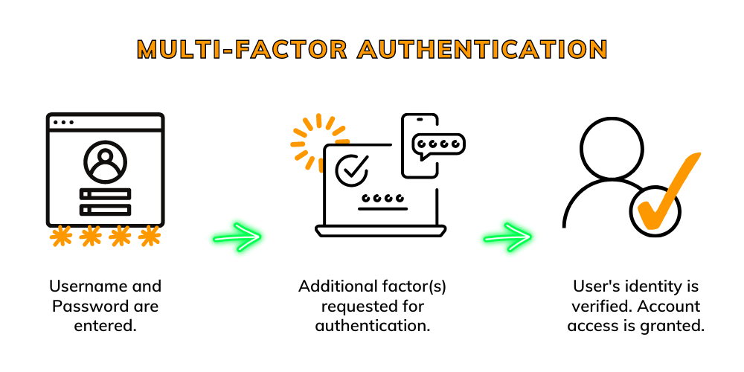

Slide 9
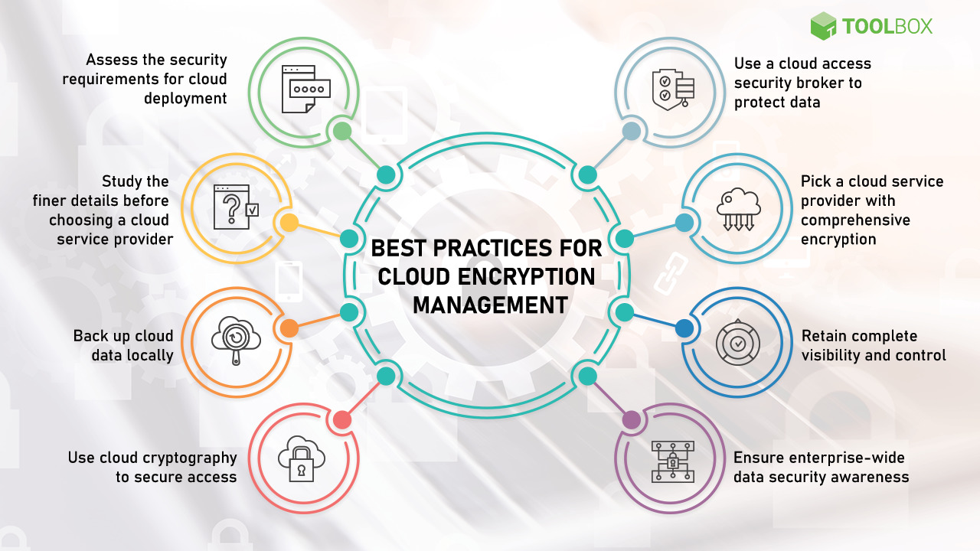

Slide 10
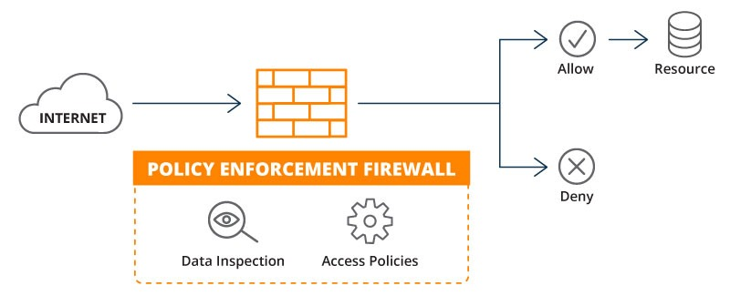
Firewalls and Network Security

Slide 11
Cloud Security Architectures
Shared Responsibility Model
Zero Trust Architecture
Microservices Security
Container Security

Slide 12
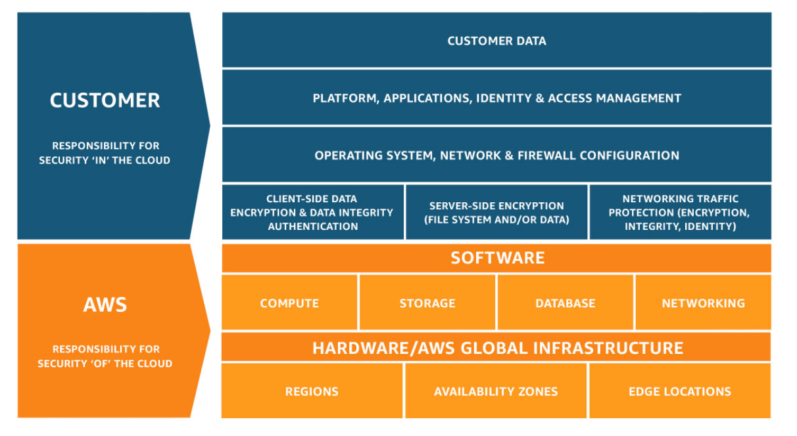
Cloud Security Architectures
Shared Responsibility Model is the way in which Cloud Service Providers (CSPs) and customers share responsibilities for security when using cloud services.
AWS

Slide 13
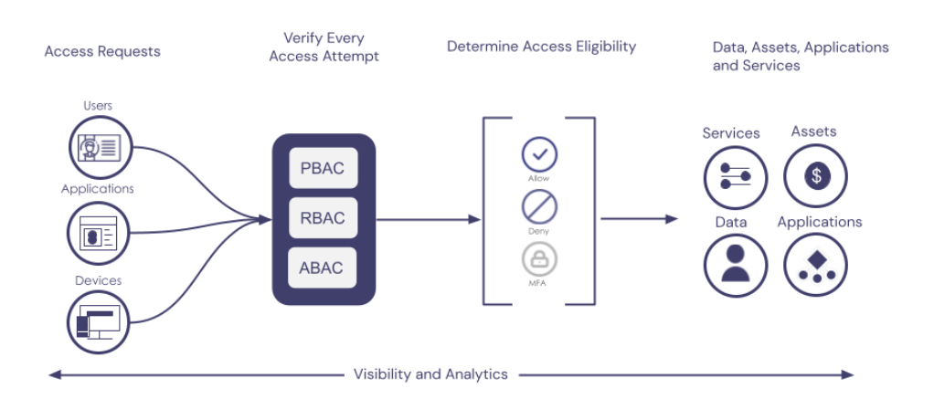
Cloud Security Architectures
Zero Trust Architecture is a security model that requires no trust in any source, even those located within the internal network.

Slide 14
Cloud Security Architectures
Microservices Security
focuses on safeguarding applications and services built using the Microservices architecture. It often involves measures such as authentication, authorization, encryption, and key management to ensure security in the complex and distributed environment of independent services.
Container Security
relates to ensuring the safety and isolation of containers, such as Docker containers. It includes access controls, monitoring, and protection against security risks like running malicious code or interfering with a container. Measures such as secure image management, limiting container privileges, and key management are essential components of container security.

Slide 15
Cloud Security Architectures
Core Principles of Cloud Security Architecture
Confidentiality
Integrity
Availability
Shared Responsibility

Slide 16
Identity and Access Management (IAM)
Data Security
Endpoint Security
5 Key Components of Cloud Security Architecture
Network Security
Application Security

Slide 17
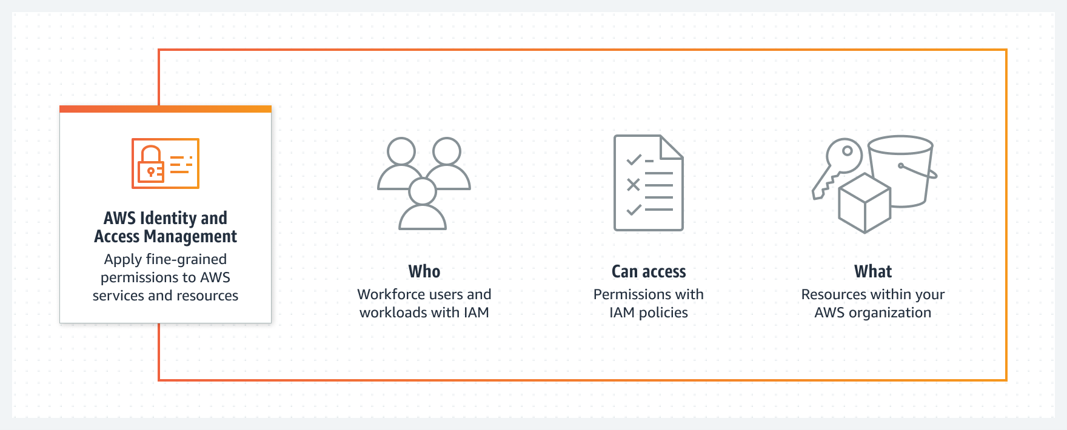
AWS Identity and Access Management

Slide 18
ISO/IEC 27017
SOC 2 Type II
Cloud Security Standards
Cloud Security Alliance (CSA) STAR Program
NIST 800-53
….

Slide 19
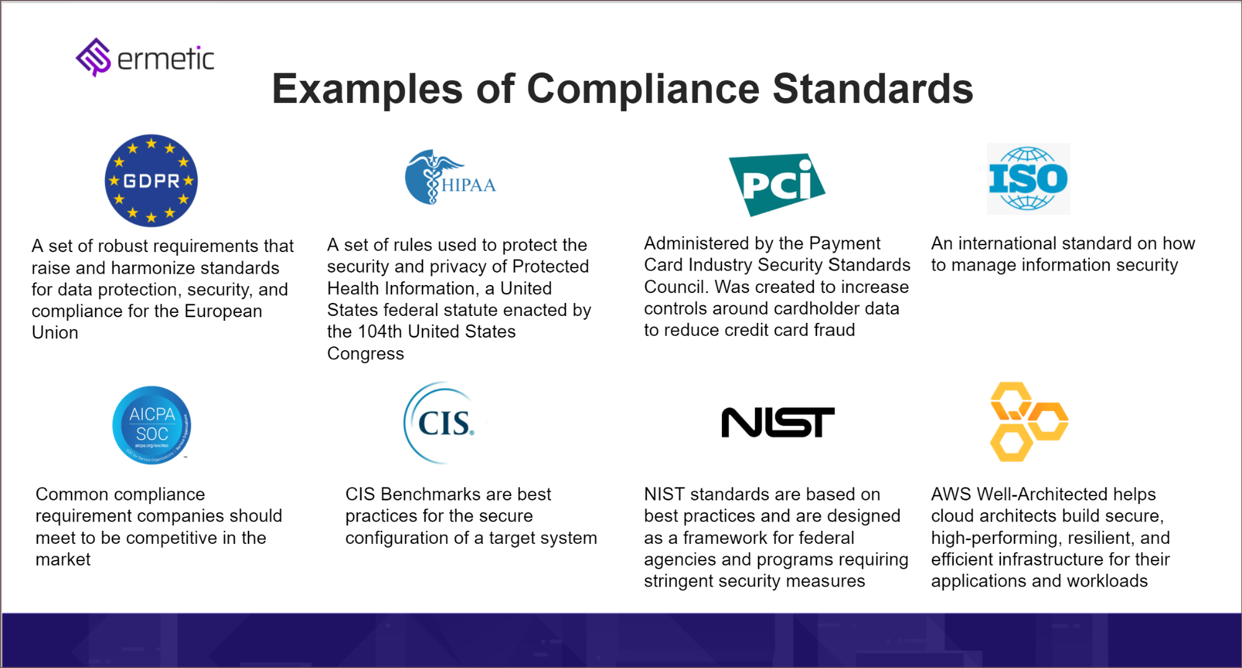

Slide 20
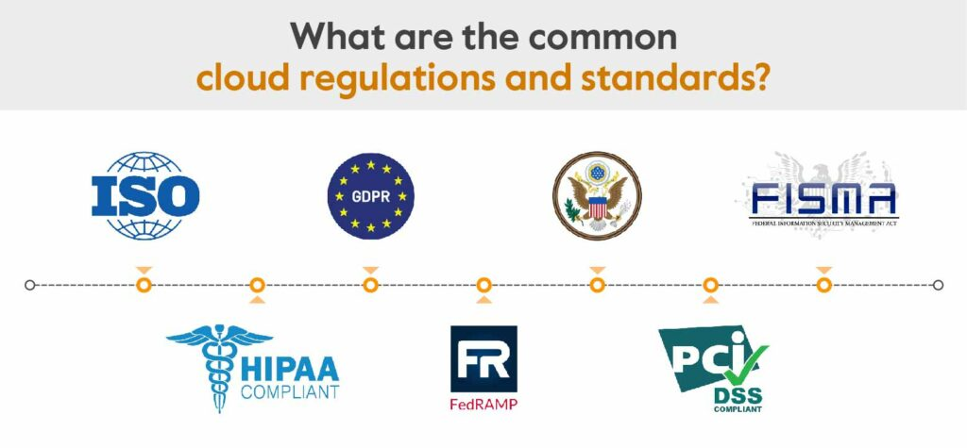

Slide 21


Project
PROJECTS
Project

Slide 22
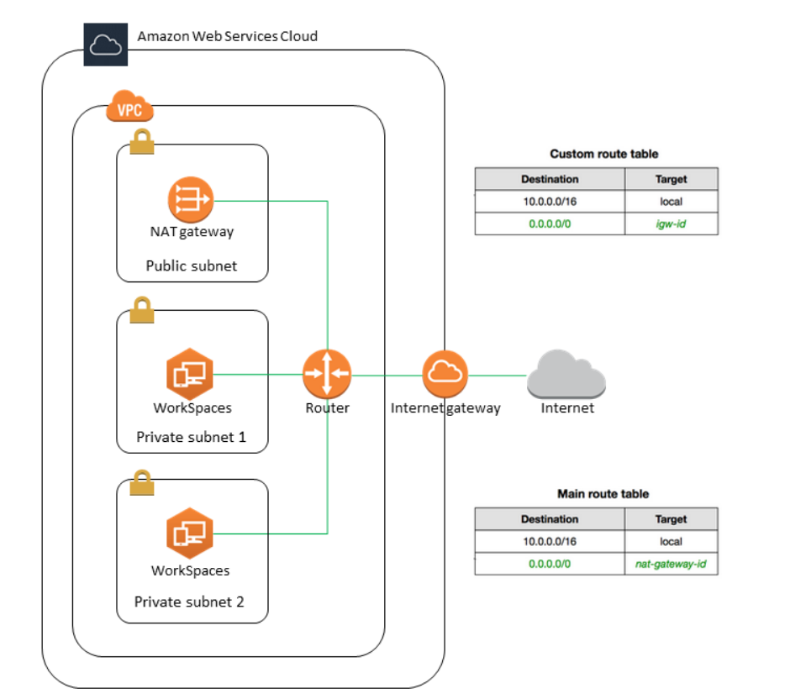

Slide 23

THANK YOU!

